Slide 1
Gender Name Prediction
Gauri Dandi and Maura Keith

Slide 2
Motivation
Train and compare the performance of multiple ML models to predict the gender of a name
See if model is viable and what features it draws upon
Notes:
Maura

Slide 3
Ethical Considerations
Use ethically obtained data
Initial dataset choice from Facebook leak
Use dataset from social security applications
Use only aggregately, do not apply to individuals
Notes:
Gauri

Slide 4
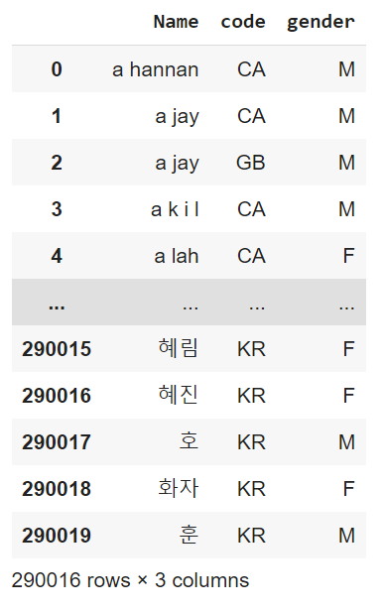
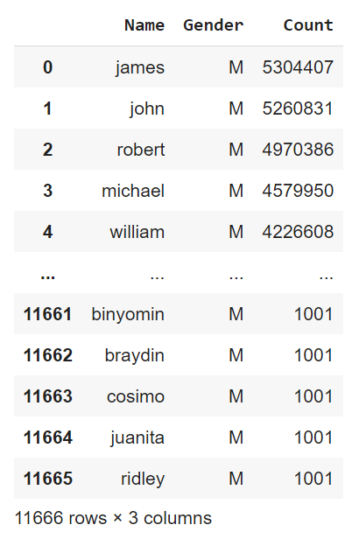
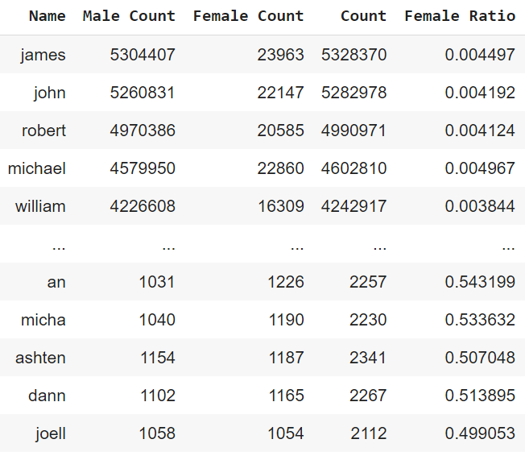
Data and Data Cleaning
Harvard dataset
300,000 names by country
Binary gender assignment
Filter for English alphabet only
UC Irvine dataset
11,000 unique names
Binary gender assignment with counts
Find ratio of male/female
Only keep names with at least 1,000 instances

Slide 5
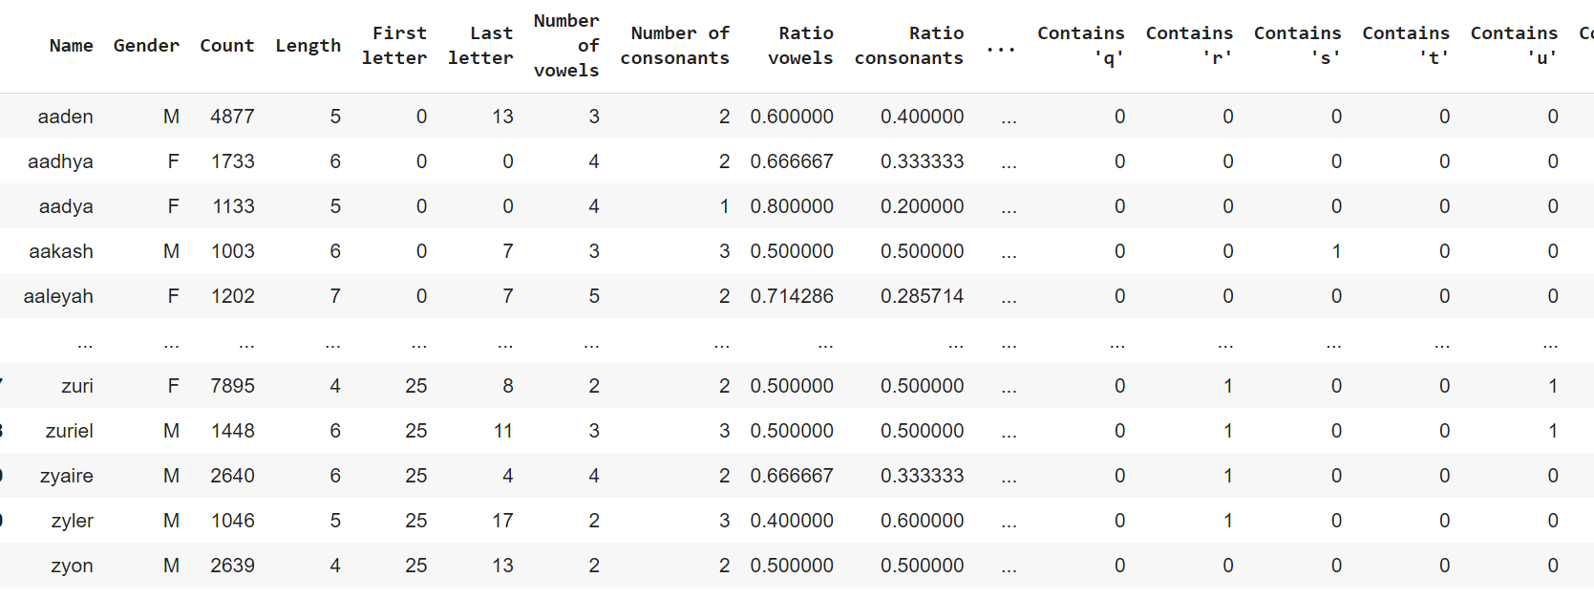
Feature Engineering
Last letter
Integer to represent character
Name length
Number of vowels
Ratio of vowels
Feature engineering
One-hot encoding for letters in name
0 or 1
First letter
Integer to represent character

Slide 6
Approaches
Represent target variable in different ways:
Binary
Male or female
Assign to gender most commonly assigned
Continuous scale
Ratio female
Neutral names
Male, female, or neutral
Assign neutral if less than 95% majority one gender

Slide 7
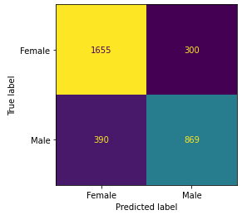
Model Results - Binary
Logistic regression
77% testing accuracy
Evaluate by country using binary Harvard dataset
Only countries with > 100 instances
Logistic regression confusion matrix
Rank | Country | Accuracy (%) | Sample size
1 | Latvia | 97 | 689
2 | Czech Republic | 91 | 479
3 | Lituania | 90 | 849
… | … | … | …
29 | Republic of Moldova | 78 | 408
30 | United States | 77 | 96,592
31 | Belgium | 77 | 1500
… | … | … | …
52 | India | 56 | 2774
53 | Japan | 50 | 1631
54 | Vietnam | 45 | 312

Slide 8
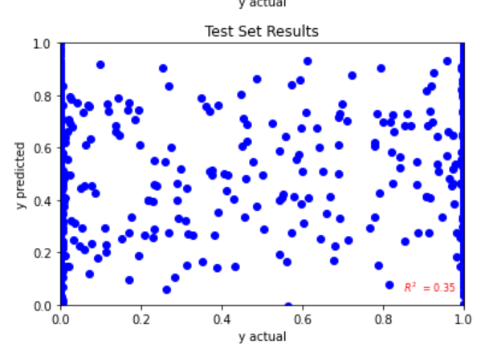
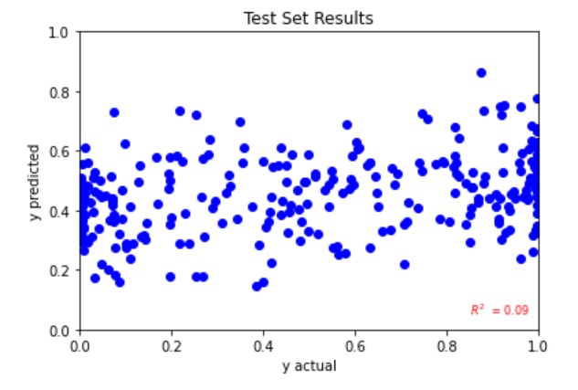
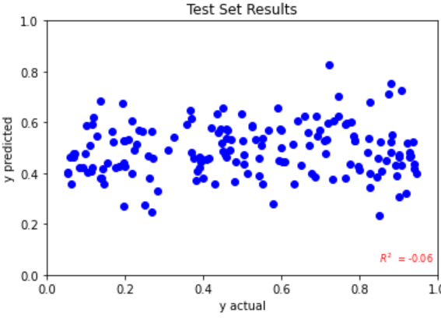
Model Results - Continuous scale
Linear regression
Poor performance
Performance decreases as binary names removed
All names - R² = 0.35
Names that appear for both genders R² = 0.09
Names assigned to neutral - R² = -0.06

Slide 9
Model Results - Neutral
Logistic Regression
74% testing accuracy
SVC
74% testing accuracy
Random Forest
83% testing accuracy
Neural Network
85% testing accuracy

Slide 10
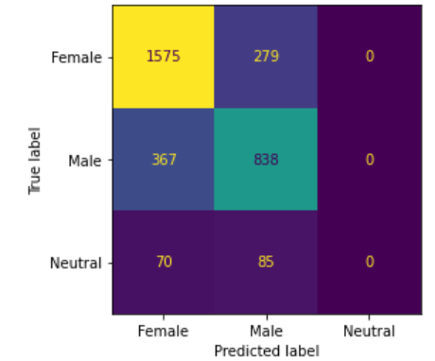
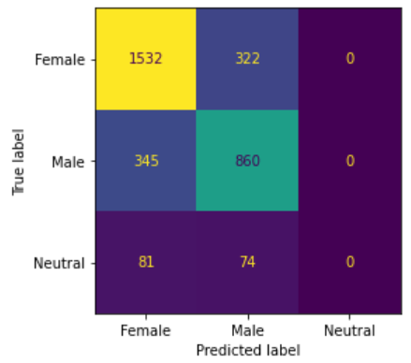
Logistic Regression and SVM
Never categorize name as ‘neutral’
Functionally same as binary classifier
Slightly lower accuracy than binary because all neural names misclassified
Generally does not favor classifying male or female
Logistic Regression confusion matrix
SVC confusion matrix

Slide 11
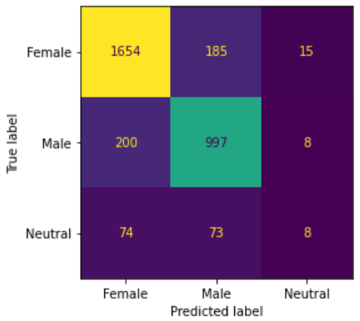
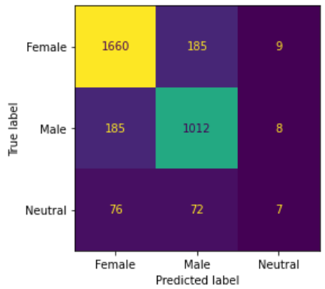
Random Forest
Rank | Feature | Importance
1 | Last letter | 0.31
2 | First letter | 0.076
3 | Ratio consonants | 0.050
… | … | …
6 | Contains ‘o’ | 0.039
7 | Contains ‘y’ | 0.037
8 | Length | 0.027
… | … | …
33 | Contains ‘q’ | 0.0027
Highest misclassification on neutral names
Hyperparameter tuning
82.7% → 83.4% accuracy
Feature importance analysis
Pre-tuning confusion matrix
Post-tuning confusion matrix

Slide 12
Random Forest - Name Classification Case Study
 |  | Predicted
 |  | Male | Female | Neutral
Actual | Male | James, John, Michael | Timothy, Peter, Billy | Dylan, Evan, Gage
 | Female | Ruth, Rose, Doris | Elizabeth, Linda, Ashley | Ona, Jailyn, Kenyetta
 | Neutral | Terry, Logan, Robin | Kelly, Jamie, Dana | Kamryn, Reece, Jaelyn

Slide 13
Long Short-Term Memory RNN
Advantages:
Goal is to learn from longer sequences of data
LSTM’s use memory gates to retain/forget patterns learned during training
Used 1D CNN for character embedding as inputs to the model
Notes:
Gauri

Slide 14
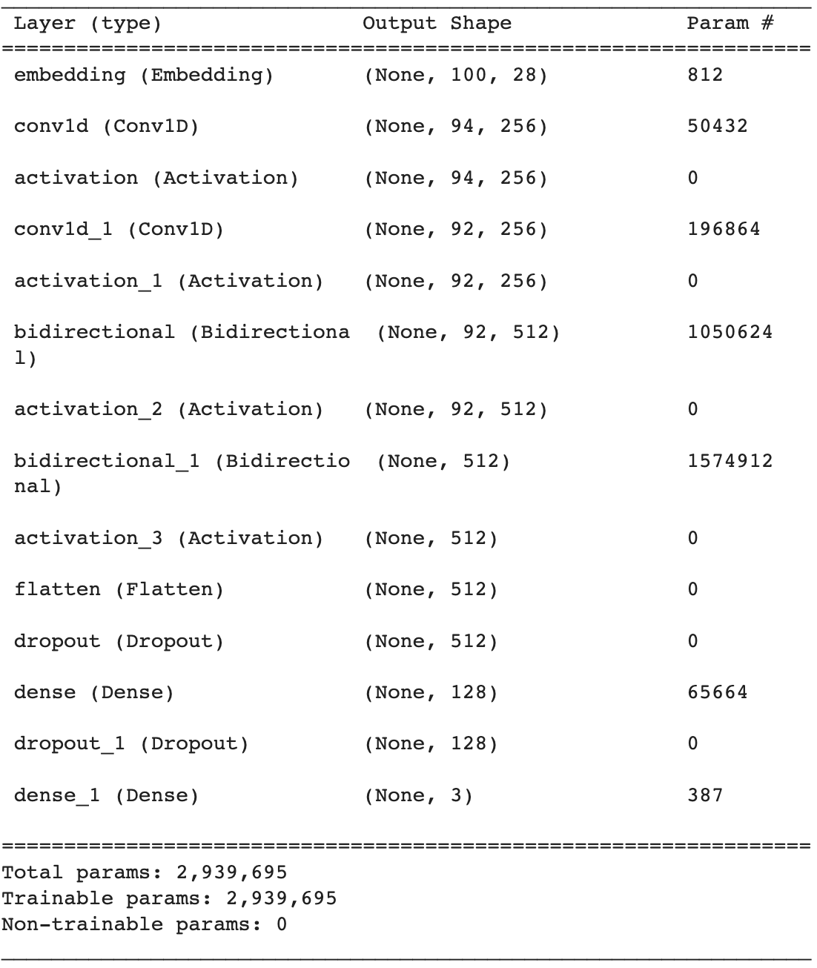
RNN Architecture
Character embedding
LSTM Model
Notes:
Gauri

Slide 15
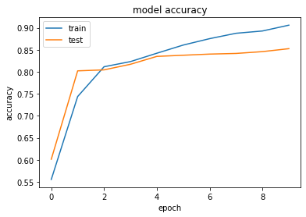
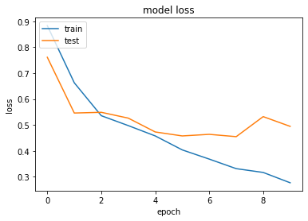
LSTM RNN - Results
10 epochs with batch size 128
Ultimately achieved train accuracy of 90.6% and test accuracy of 85.3%
None of the test data had been seen during training
Notes:
Gauri

Slide 16
Discussion
Simpler models draw most heavily upon the last letter of name
LSTM relies upon character sequences
Gender can commonly be estimated by a model
There are always exceptions
Most accurate for countries with names structured in general ‘English’ format
Notes:
Gauri

Slide 17
Further Work
Combine character embedding with other derived features for LSTM RNN
Tune threshold for neutral names
Apply model to mined data and view trends
Notes:
Maura

Slide 18
Questions?
Notes:
Maura

